Slide 1

بسم الله الرحمن الرحیم

Slide 2
Hysteroscopic approach in infertility
Dr. Fatemeh Tabatabaei
Fellowship of Gynecologic Laparoscopic Surgeries

Slide 3
Uterine polyps
They are hyperplastic overgrowths of endometrial glands and stroma that form a projection from the surface of the endometrium.
The great majority of endometrial polyps are benign, but malignancy occurs in some women.
Several molecular mechanisms have been proposed to play a role in the development of endometrial polyps.
These include monoclonal endometrial hyperplasia, overexpression of endometrial aromatase, and gene mutations.
Endometrial polyps are rare among adolescents.
The prevalence appears to rise steadily with increasing age, and to be higher in postmenopausal than in premenopausal women (12 versus 6 percent in one study).
Among women undergoing endometrial biopsy or hysterectomy, the prevalence of endometrial polyps is 10 to 24 percent.

Slide 4
Polyp Effect on fertility and pregnancy
Reported prevalence in those undergoing in vitro fertilization is 6 to 8 percent.
There are few data regarding the impact of removal on fertility.
Although most clinicians perform polypectomy in infertile women
Only a systematic review showed a higher pregnancy rate in women undergoing intrauterine insemination who underwent polyp removal compared with hysteroscopy alone.
Endometrial polyps do not appear to be associated with an increased risk of spontaneous abortion or adverse obstetric outcomes.

Slide 5
Diagnostic evaluations
Transvaginal ultrasonography(TVUS), Saline infusion sonography (SIS) and Hysteroscopy are three diagnostic modalities for diagnosis of polyps.
A systematic review of over 5000 women reported a similar performance for the diagnosis of polyps for all three modalities: sensitivity (TVUS: 91 percent; SIS: 95 percent; hysteroscopy: 90 percent) and specificity (90 and 92 and 93 percent)
Both SIS and hysteroscopy give a better sense of the shape of the lesion than TVUS alone.
The advantage of SIS compared with hysteroscopy is that the adnexa are also visualized.
The advantage of hysteroscopy compared with SIS is the simultaneous treatment opportunities

Slide 6
ManAGEMENT APPROACH
Symptomatic polyps (AUB
Polyp >1.5 cm in diameter
Multiple polyps
Polyp prolapsed through the cervix
Infertility
Postmenopausal women
Tamoxifen users

Slide 7
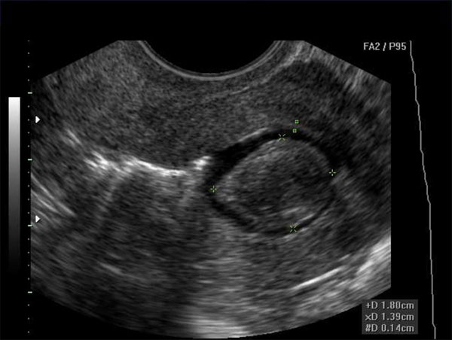
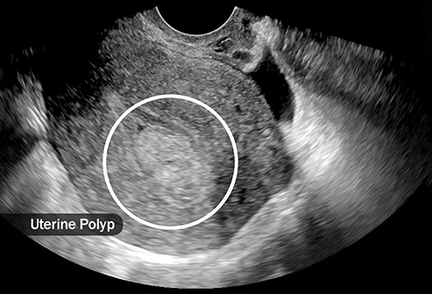
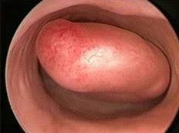
three diagnostic modalities
Uterine polyp in saline infusion sonography
Uterine polyp on transvaginal ultrasonographic study
Hysteroscopic view of uterine polyp

Slide 8
indications for hysteroscopic myomectomy
Abnormal uterine bleeding
Recurrent pregnancy loss
Infertility
fibroids that distort the cavity ( [FIGO] types 0 to 3 ) have more of an impact on fertility, and surgical treatment can be effective in reversing the impairment of pregnancy.
Fibroids which are located near the serosal surface, the less a role they appear to play

Slide 9
Other indications of hysteroscopic myomectomy
Dysmenorrhea
Leukorrhea Necrotic leiomyoma following uterine fibroid embolization, magnetic resonance imaging (MRI)- focused ultrasound, or transcervical ultrasound therapy
Histologic evaluation of intracavitary lesions with uncertain findings on pelvic imaging
History of preterm delivery
Postpartum hemorrhage
Puerperal infection arising in or exacerbated by a submucosal fibroid
Postmenopausal bleeding

Slide 10
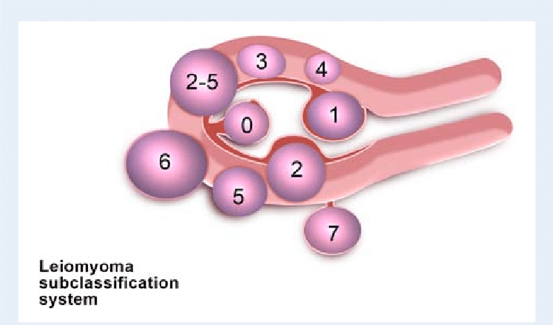
Submucosal uterine myomas (FIGO classification)
Submucosal myomas characteristically appear as white spherical masses covered with a network of fragile thin-walled vessels when viewed by hysteroscopy.
In general, type 0 and type 1 myomas are candidates for resection, while type 2 myomas are best excised by laparoscopic or open technique.

Slide 11
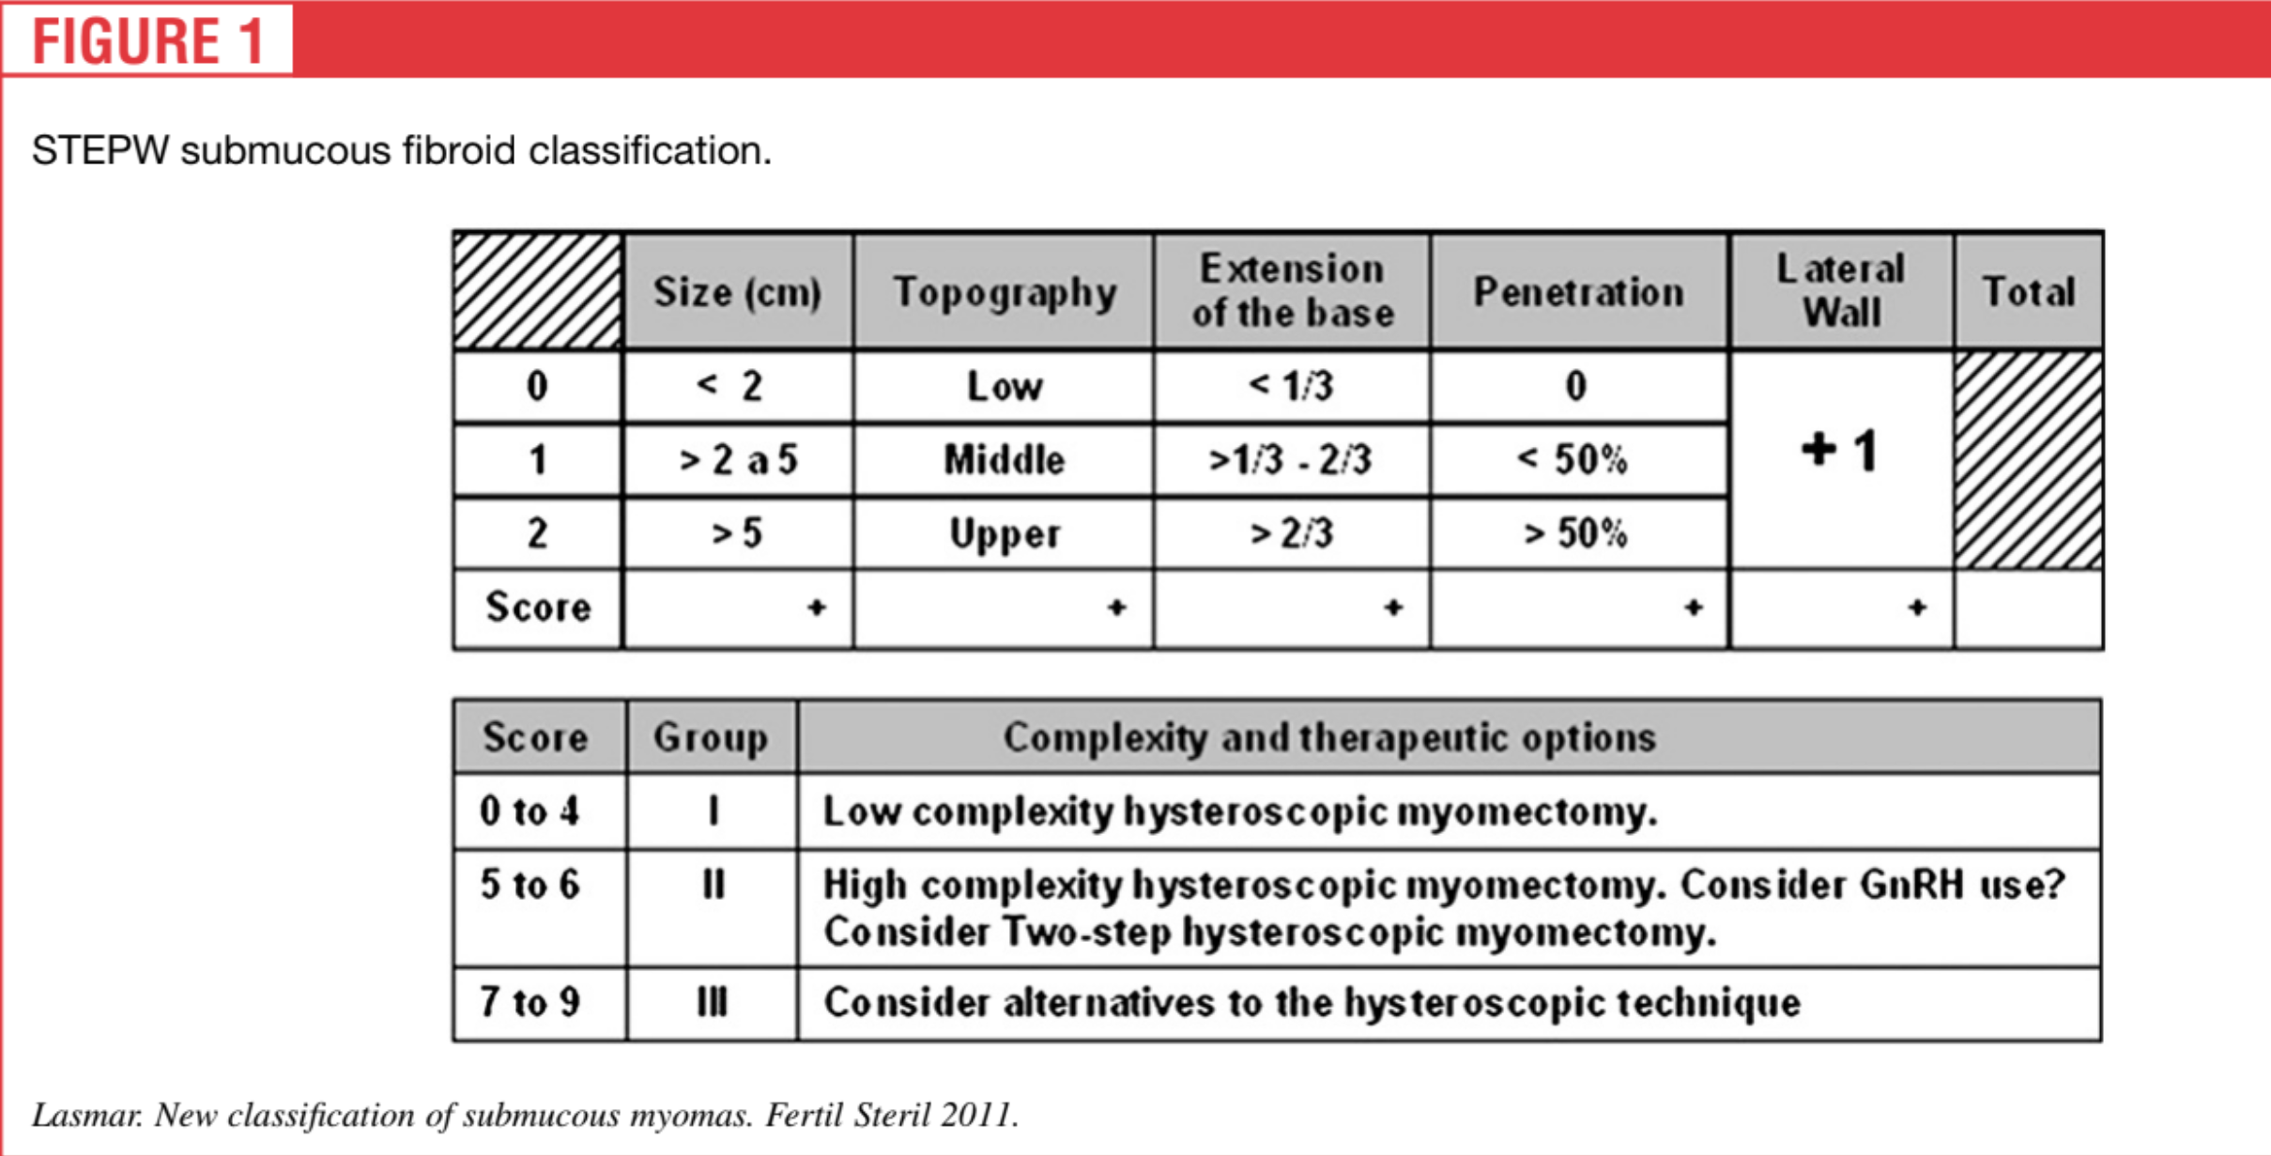
Step-w classification
Size
Topography: defined by the third of the uterine cavity where the fibroid is situated.
Extension of the base of the myoma.
Penetration of the nodule into the myometrium
Wall: when the fibroid is on the lateral wall, 1 extra point is added regardless of the third that is affected

Slide 12
How to diagnose?
Three-dimensional saline infusion sonography, single modality that can evaluate the relationship of a leiomyoma to both the endometrial cavity and the myometrium.
An alternative is to use a combination of office-based diagnostic hysteroscopy and transvaginal ultrasonography.
HSG and CT_Scan have limited use in delineating fibroid location.
MRI is too expensive.
For patients with enlarged uterine size (ie, 14 to 16 weeks or larger on pelvic examination), SIS may be impractical, and MRI maybe useful to evaluate type 0-1- 2 myomas.

Slide 13
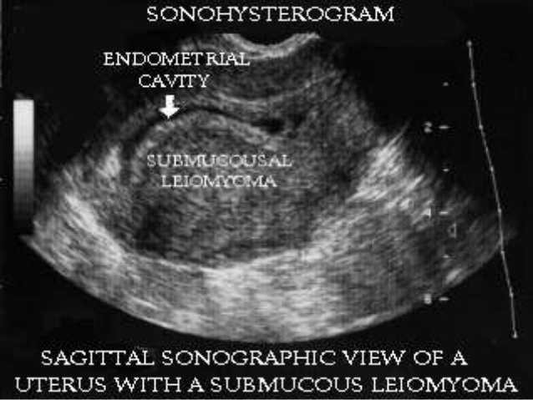
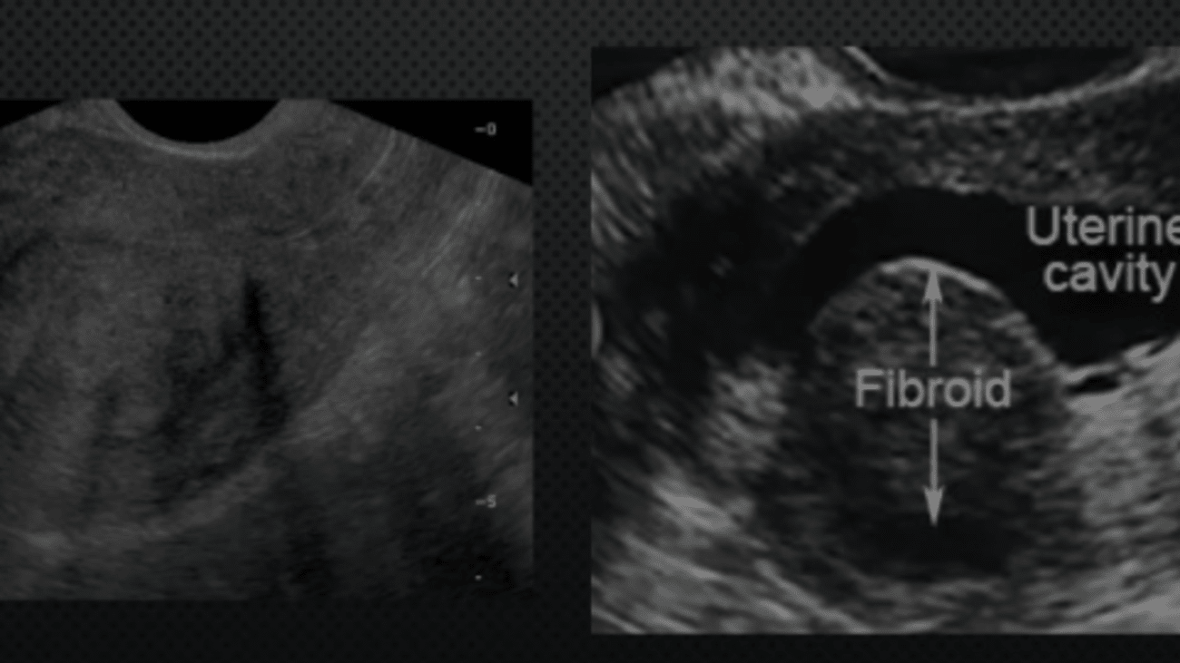
Sonographic evaluation

Slide 14
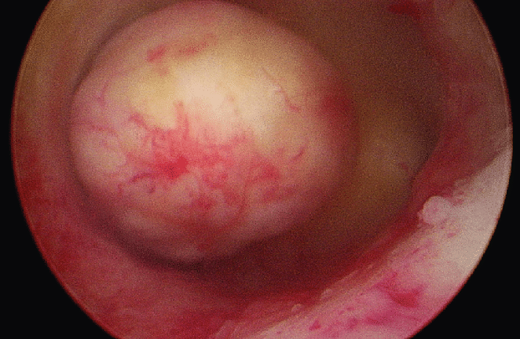
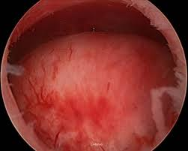
using the STEPW classification permits greater correlation with incomplete or complete removed of the fibroid by hysteroscopic myomectomy than does use of the ESGE system

Slide 15
Pre and post-operation management
GnRH agonists: in patients with severe anemia that may preclude surgery, those in whom intravenous iron therapy is contraindicated, or those who refuse blood products.
Vazopressin: we mix 10 units in 100 mL of normal saline and inject into the cervical stroma in 5 mL aliquots at the 10, 2, 5, and 8 o'clock positions around the ectocervix. This dose can be repeated every 30 to 45 minutes if bleeding is encountered or the procedure is prolonged.
Intrauterine pressure may be applied using a bladder (Foley) catheter balloon place inside the uterine cavity.
The Bakri balloon should not be used for intrauterine tamponade since it is too large and may cause inflammation, pain and uterine rupture.

Slide 16
Intra-Uterine adhesions (synechiae)
Scar tissue develops within the uterine cavity.
Minimal disease is characterized by thin strands of tissue stretched across the uterine cavity.
Severe disease is characterized by complete obliteration of the cavity, with the anterior wall of the uterus densely adherent to the posterior wall.
The basalis layer appears to be most susceptible to damage in the first four postpartum or postabortal weeks.
In addition to adhesion, vascularization may be compromised due to endometrial damage and scarring.
These changes account for the menstrual abnormalities, frequent dysmenorrhea, infertility, and recurrent pregnancy loss.

Slide 17
Risk factors
Pregnancy
  Curettage after a pregnancy loss at a more advanced gestational age compared with earlier pregnancy loss.
  A different study reported a higher risk of adhesion formation in women who underwent postpartum curettage two to four weeks after delivery compared with early in the postpartum.
  Repeated curettage
Inflammation or infection (chronic endometritis)
Intrauterine procedures (removal of multiple fibroids)
Uterine compression sutures (eg, B-Lynch suture)

Slide 18
susceptibility to IUA formation following pregnancy (why?)
The low-estrogen state associated with the postpartum or postabortion time period, antagonistic effects from elevated prolactin levels associated with breastfeeding, or post-pregnancy physiologic changes that make the basalis layer more susceptible to injury.

Slide 19
CLINICAL PRESENTATION of iuas
Abnormal uterine bleeding
  Amenorrhea, light bleeding, menorrhagia, normal menses (5%)
Infertility
  blockage of sperm or injury/destruction of the endometrium that prevents implantation of the blastocyst
Cyclic pelvic pain or dysmenorrhea
  Due to obstruction of menstrual flow and/or hematometra
  Pain is typically associated with amenorrhea or hypomenorrhea
Recurrent pregnancy loss
  Abnormalities of implantation in areas of denuded endometrium or insufficient vascularization
Incidental finding

Slide 20
Diagnostic evaluations
History
Physical examination
Ultrasound
  A very thin endometrium following amenorrhea and/or endometrial irregularity with hyperechoic regions may be suggestive of IUA but this study is not definitive.
estrogen/progestin withdrawal test
Hysteroscopy
  This allows diagnosis and treatment in a single procedure and decreases the probability of trauma to the surrounding endometrium.

Slide 21
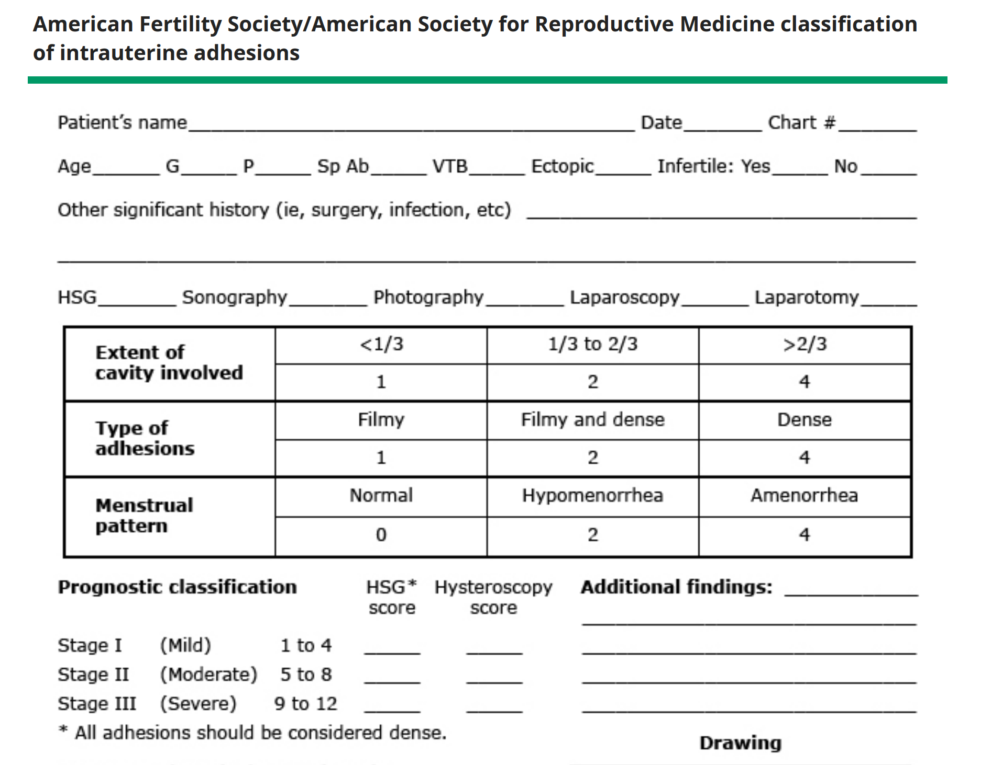
classification

Slide 22
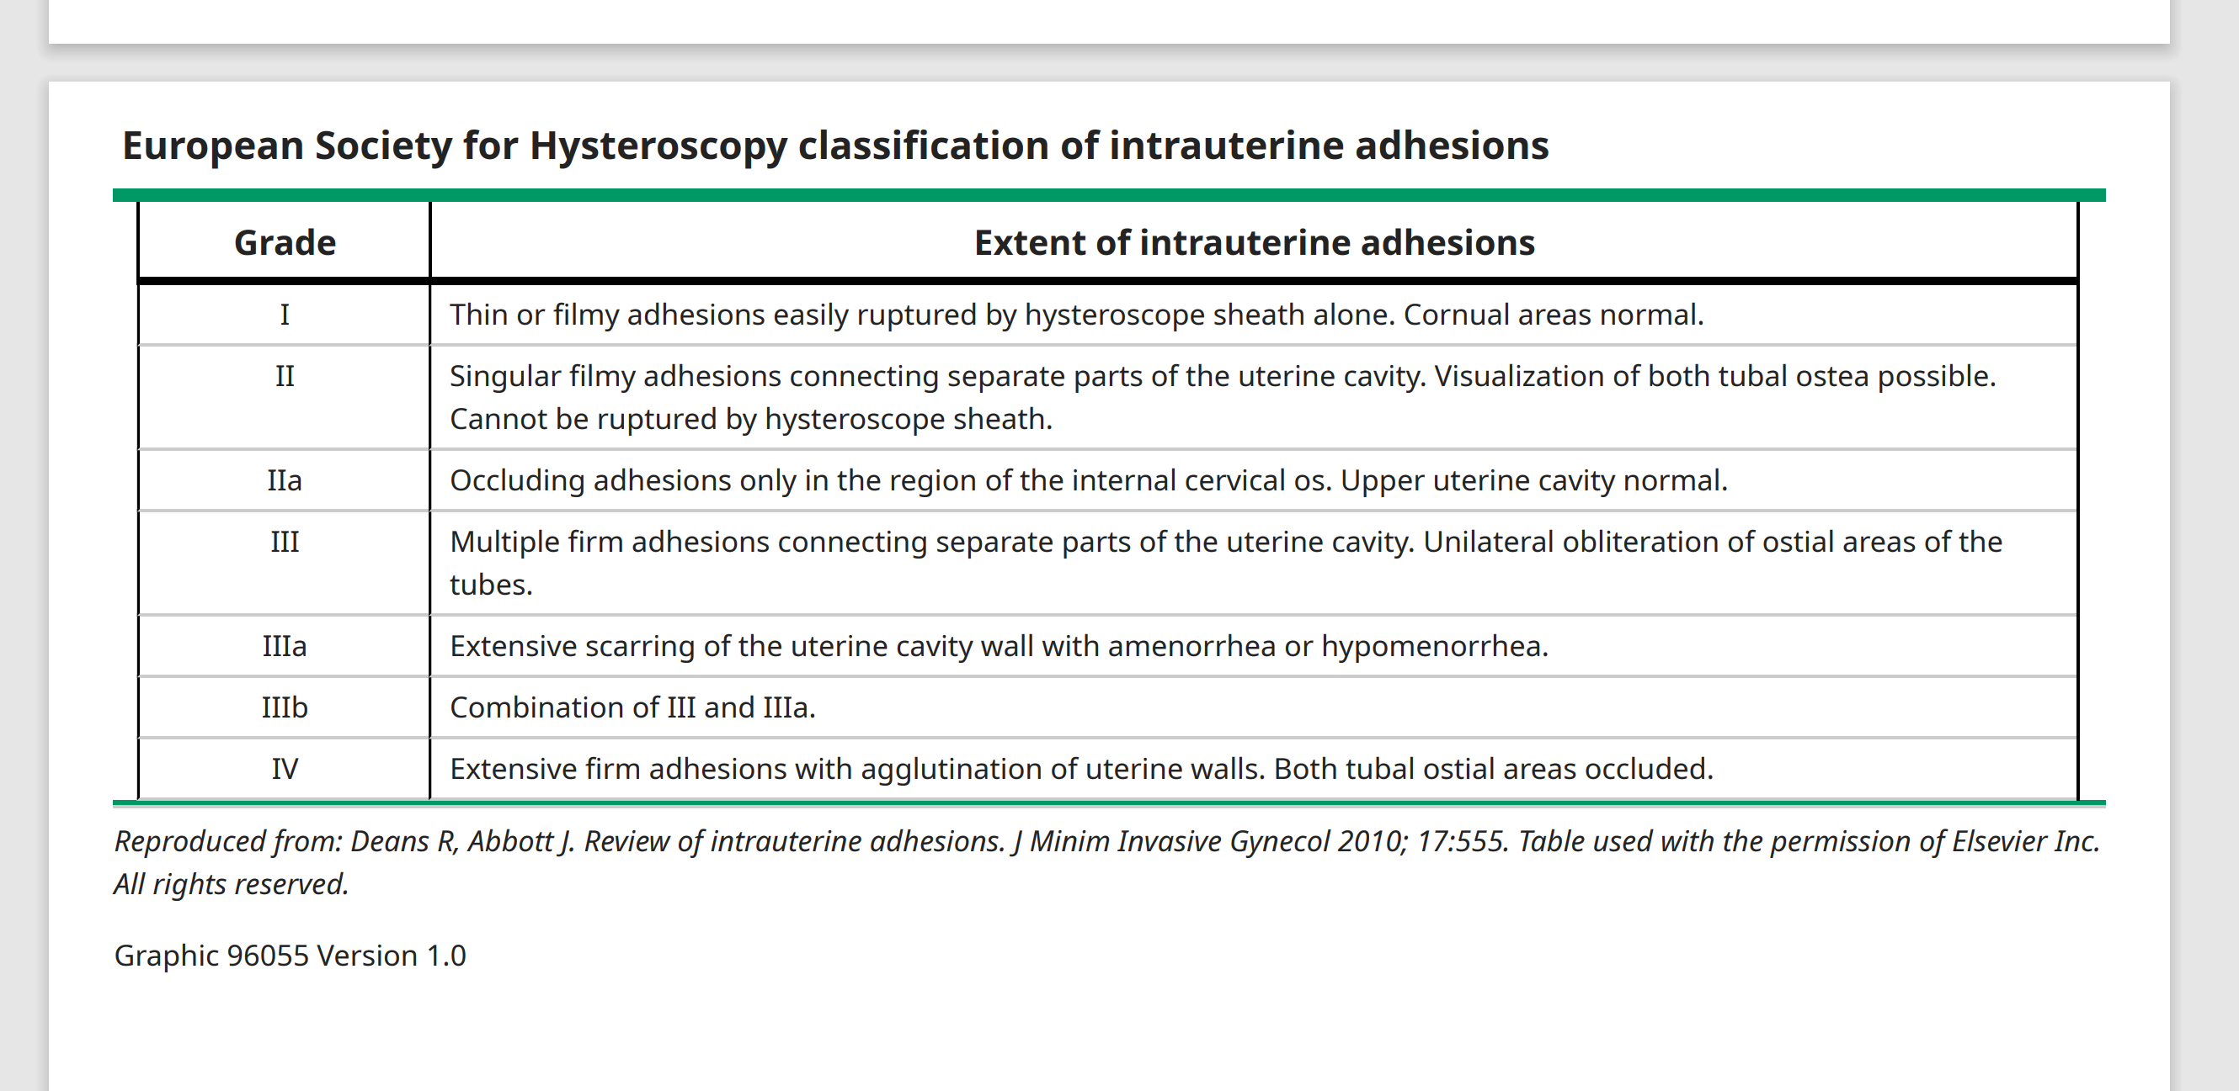
classification

Slide 23
diagnosis
Direct visualization of IUAs with hysteroscopy is the gold standard for the diagnosis
While imaging studies such as hysterosalpingography (HSG) and saline infusion sonohysterography (SIS) can detect adhesions, the sensitivity is lower compared with hysteroscopy, and therefore negative imaging studies cannot exclude adhesions
Both HSG and SIS had a 75 percent sensitivity for the detection of IUAs
Uterine anomalies, cervical stenosis, endocrine disorders of menstrual irregularity and potential etiologies of recurrent pregnancy loss are the most important differential diagnosis of IUAs.

Slide 24
treatment
Simultaneous laparoscopy is often prudent to prevent and immediately recognize perforation of the uterus.
Filmy and central adhesions should be cut first.
Marginal and dense adhesions should be addressed last.
Always cutting from below and moving upward.
A key strategy is to maintain the hysteroscope in midchannel relative to the uterine walls.
The cavity can usually be restored to reasonably normal architecture. Bleeding is not uncommon during this operation, particularly when cutting marginal adhesions, because the border between adhesion and myometrium is blurred.

Slide 25
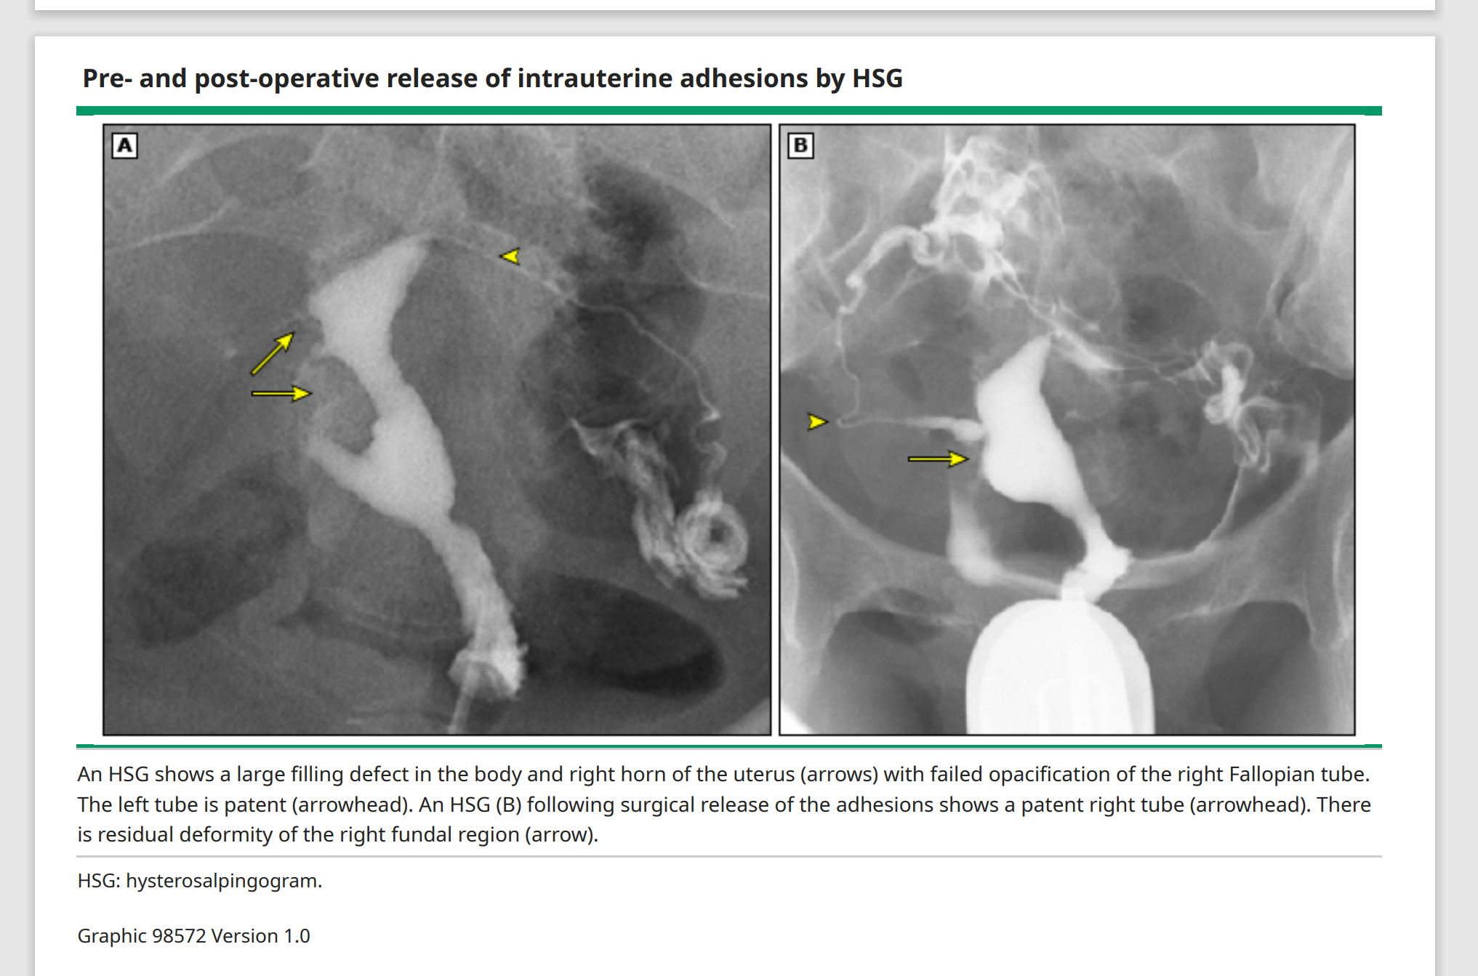
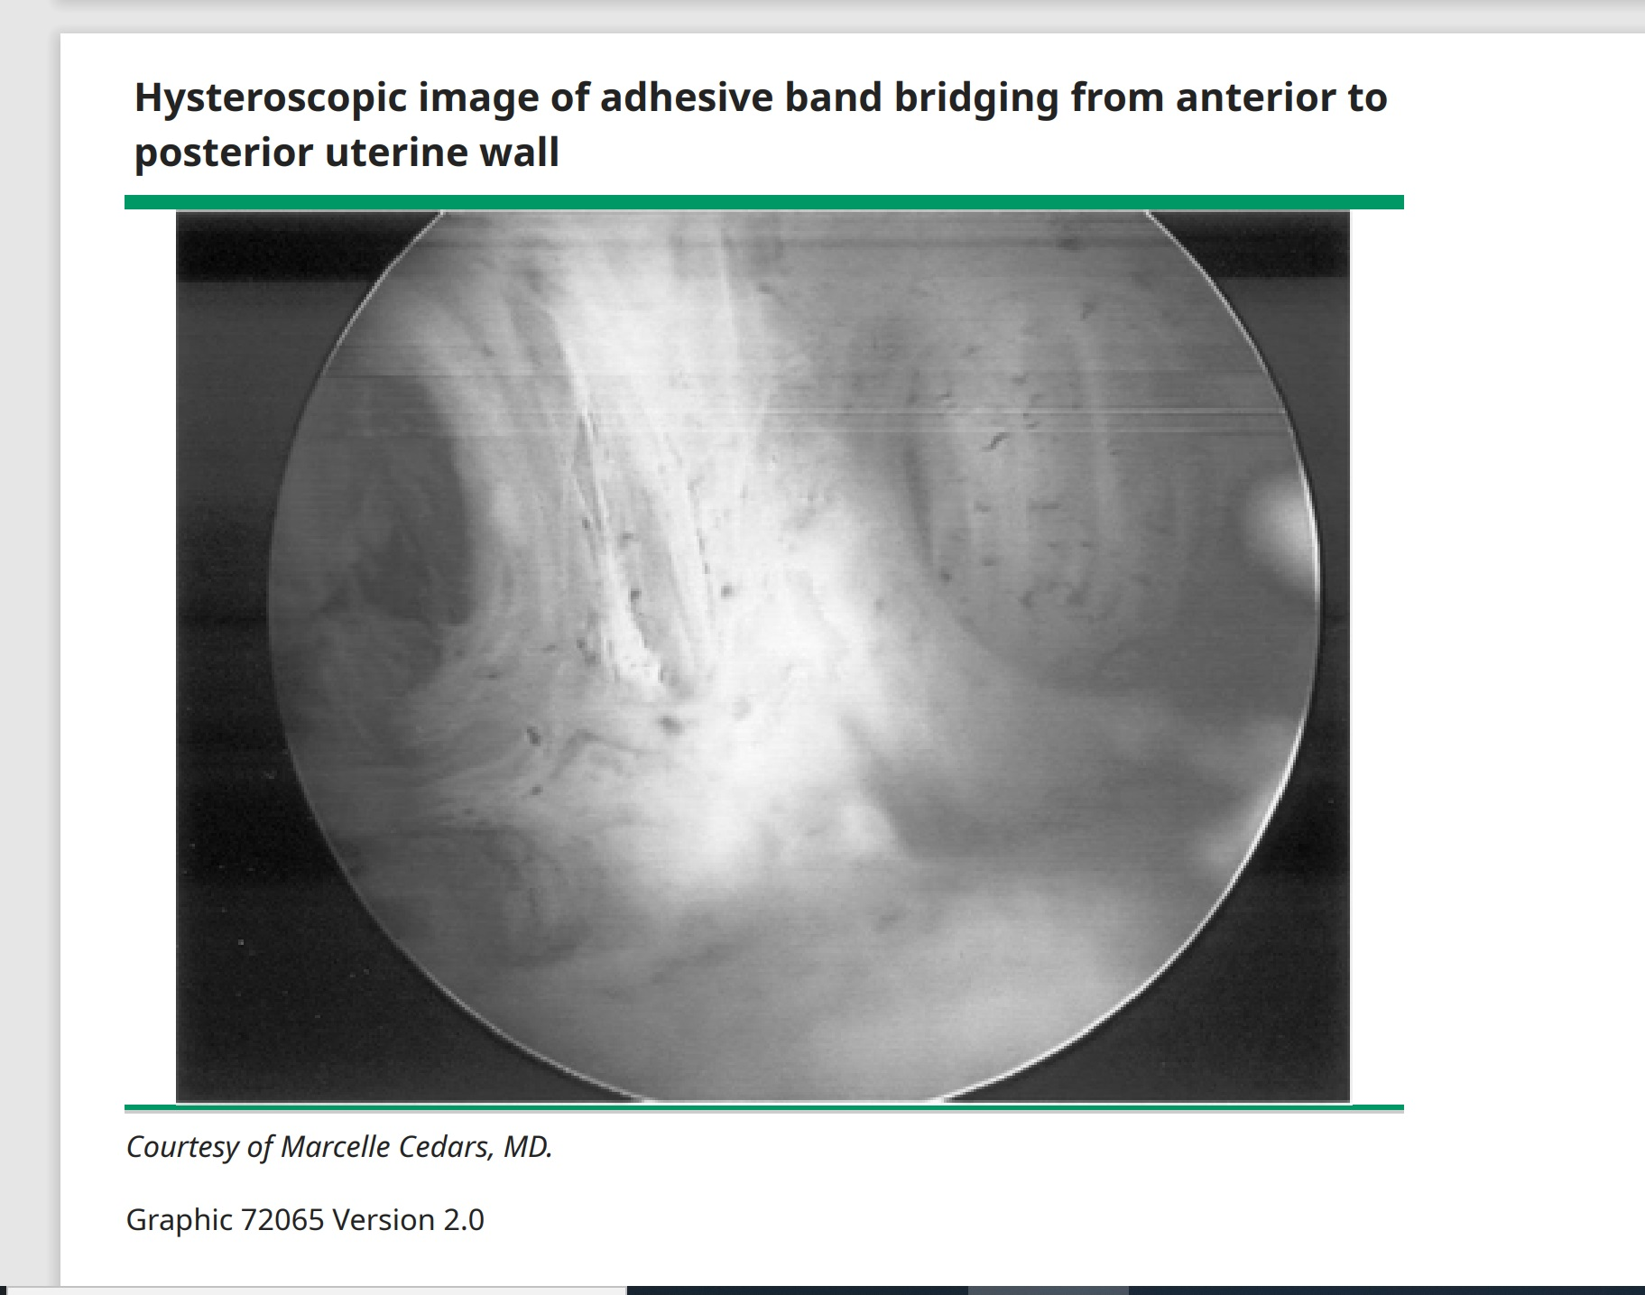
Hsg & hysteroscopic view of IUA

Slide 26
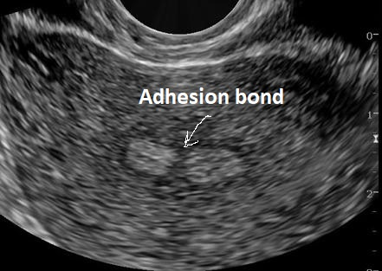
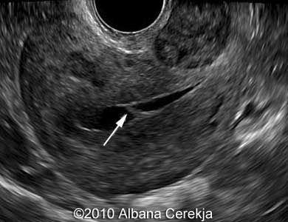
Sonographic view of uterine synechiae

Slide 27
Adhesion prevention
We use an intrauterine pediatric bladder catheter.
The catheter is removed after 7 to 10 days of use.
We give antibiotics (ie, doxycycline 100 mg twice daily for 10 day)
The patient should be placed on estrogen therapy during postoperative recovery.
A recommended time period is for 14 to 28 days postoperatively
Recommended dose is 2.5 mg oral conjugated equine estrogens daily or 6 mg oral estradiol daily.

Slide 28
Congenital uterine anomalies
Agenesis or hypoplasia
  congenital absence of the vagina, termed the Mayer-Rokitansky-Küster-Hauser (MRKH)
lateral fusion defect
  Bicornuate uterus
  Uterus didelphys.
  Failure of resorption resulting in a uterine or longitudinal vaginal septum
  Failure of formation of one of the two müllerian ducts
Vertical fusion defect
  Transverse vaginal septum
  Segmental vaginal agenesis
  Cervical agenesis or dysgenesi

Slide 29
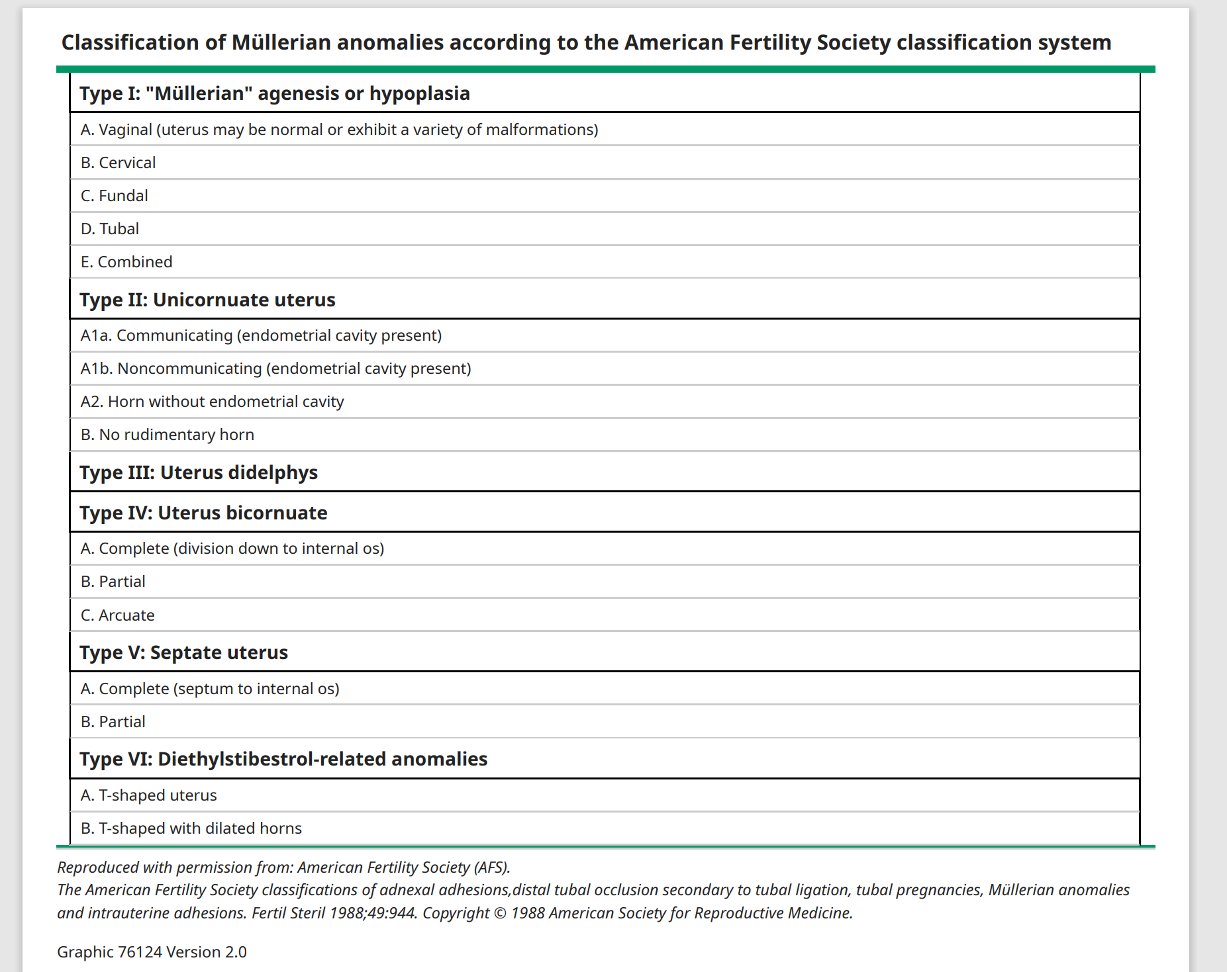
ASRM classification for cuas

Slide 30
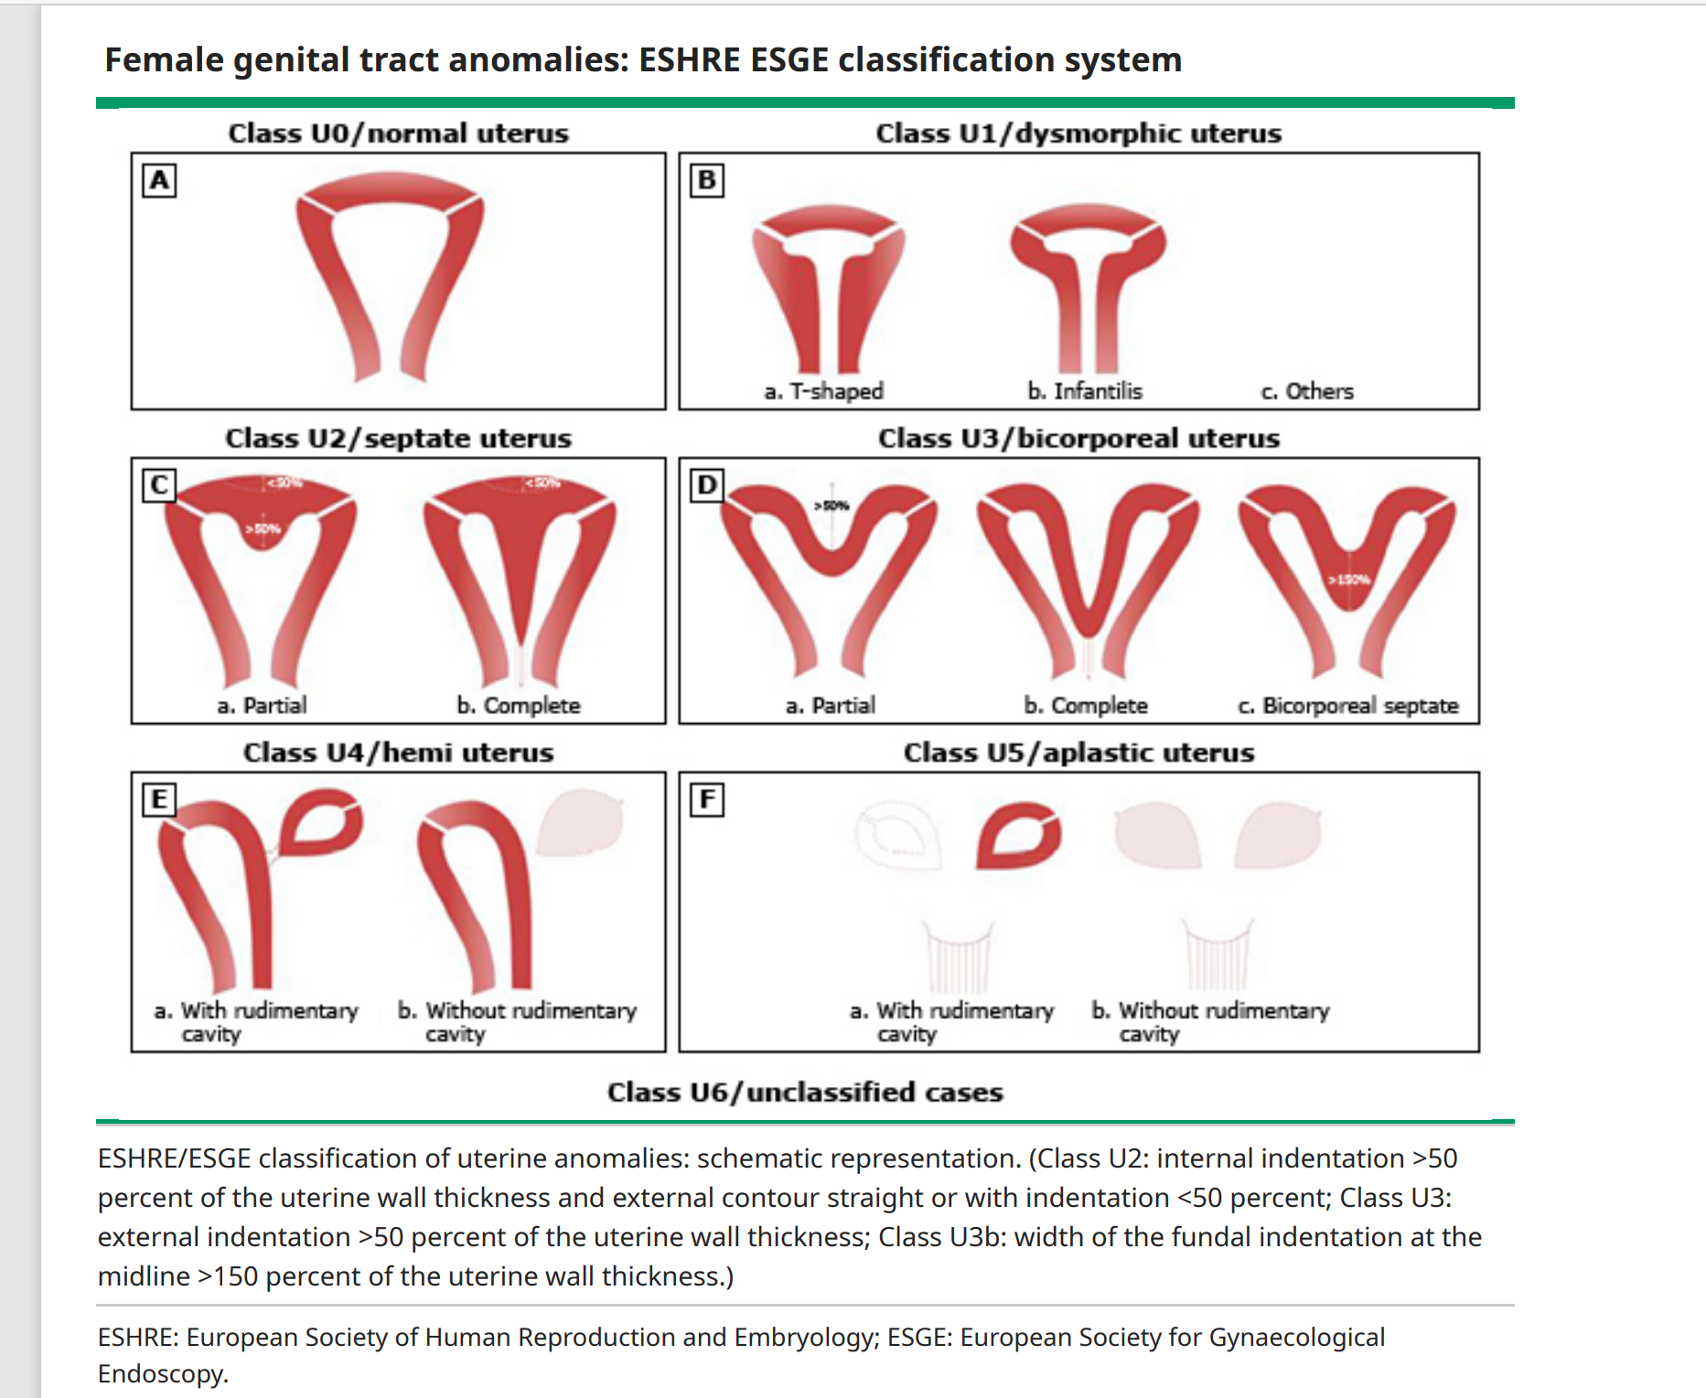
ESHRE & ESGE classification

Slide 31
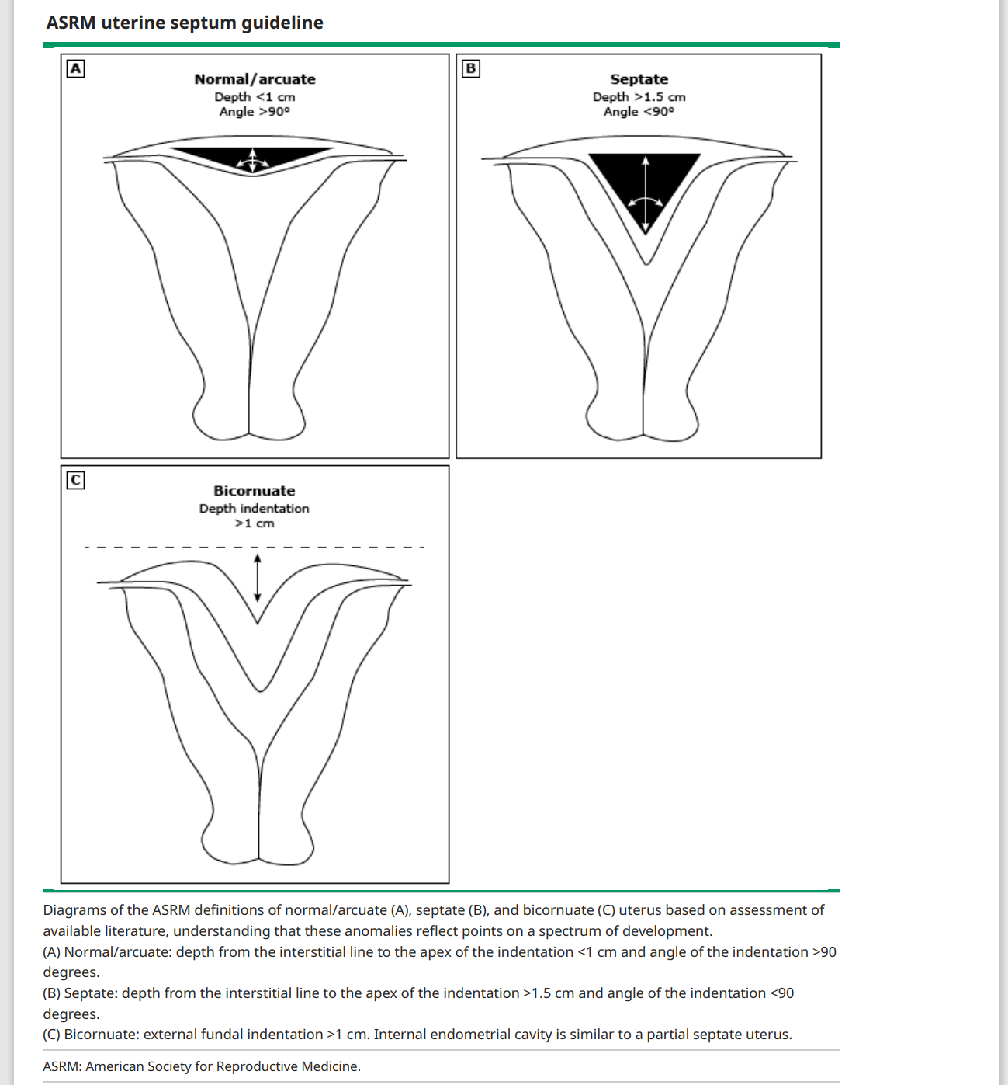
Septate uterus
The diagnosis is typically based on ultrasound findings of two closely separated endometrial cavities and a smooth fundal contour (external fundal indentation depth <1 cm; by contrast, the bicornuate uterus has an indented fundus > 1cm).
The depth from the interstitial line to the apex of the indentation is greater than 1.5 cm, and the angle of indentation is less than 90 degrees.
The septum separating the endometrial cavity is usually thin and of variable length and may extend into the cervix and vagina(longitudinal vaginal septum).

Slide 32
Clinical significance of septate uterus
Patients with septate uterus are at increased risk for spontaneous abortion (21 to 44 percent) and preterm delivery (12 to 33 percent); the live birth rate ranges from 50 to 72 percent.
There appears to be a higher risk of recurrent miscarriage associated with longer septa, but this is controversial, and many untreated patients have good pregnancy outcomes.
Pregnancy loss, when present, often occurs in the second trimester and may be distinguished from cervical insufficiency because of signs of labor. The septate uterus is also associated with an increased risk of breech presentation and abruption.

Slide 33
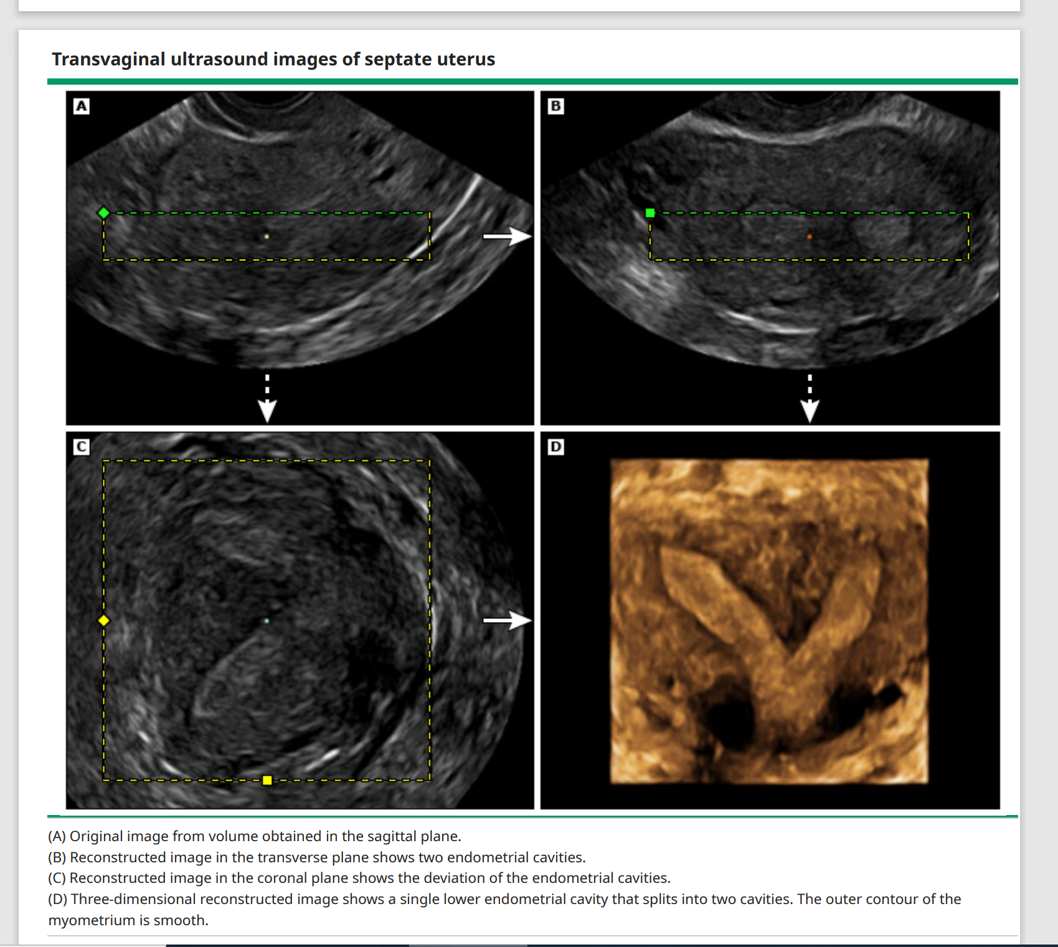
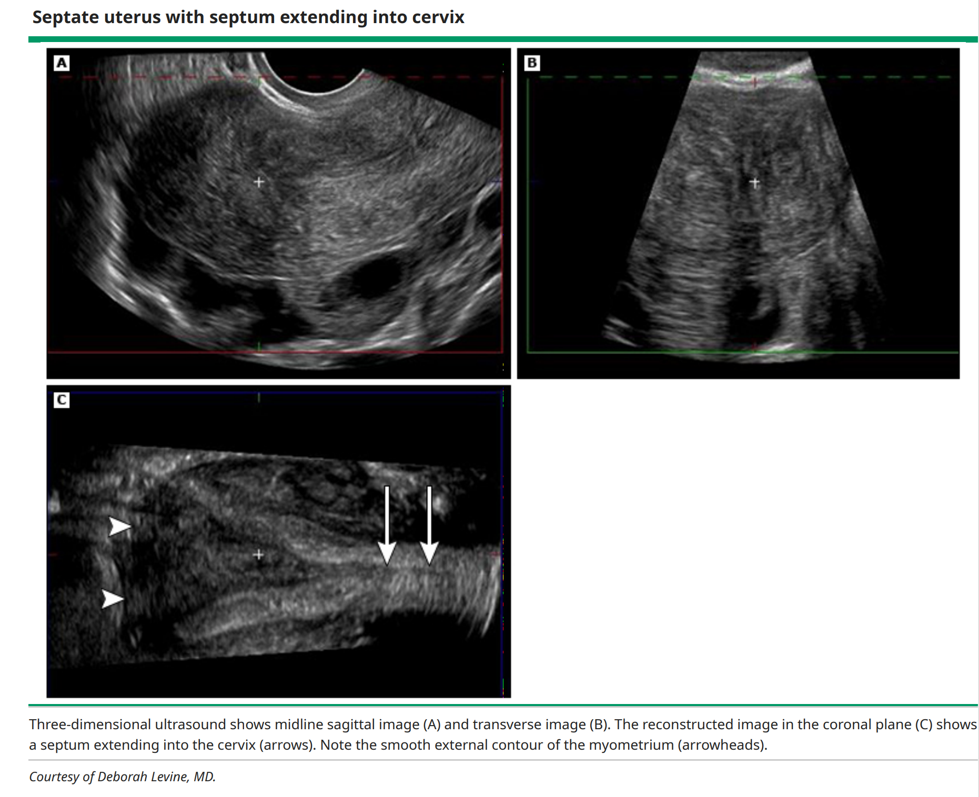
Ultrasonographic view of septate uterus

Slide 34
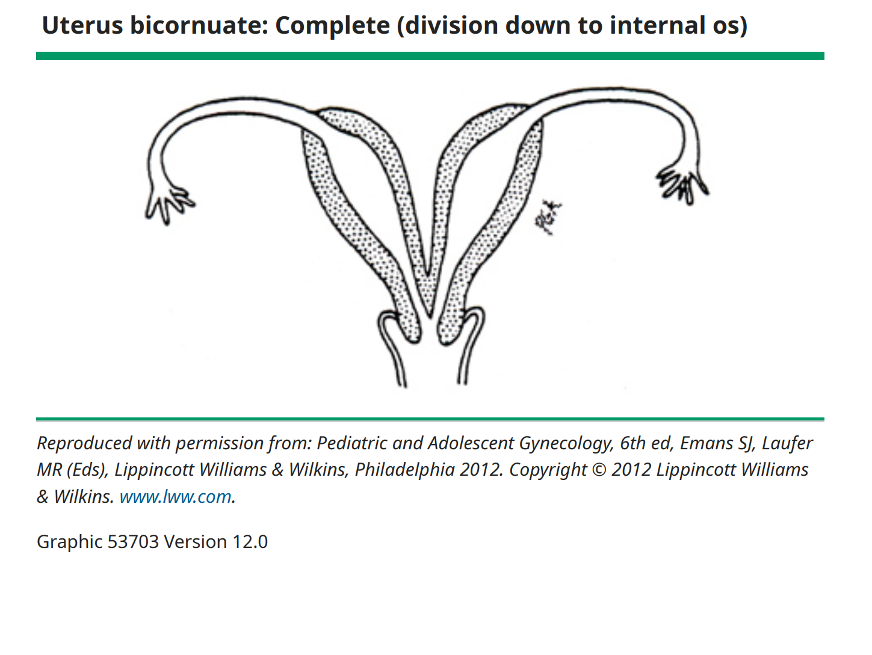
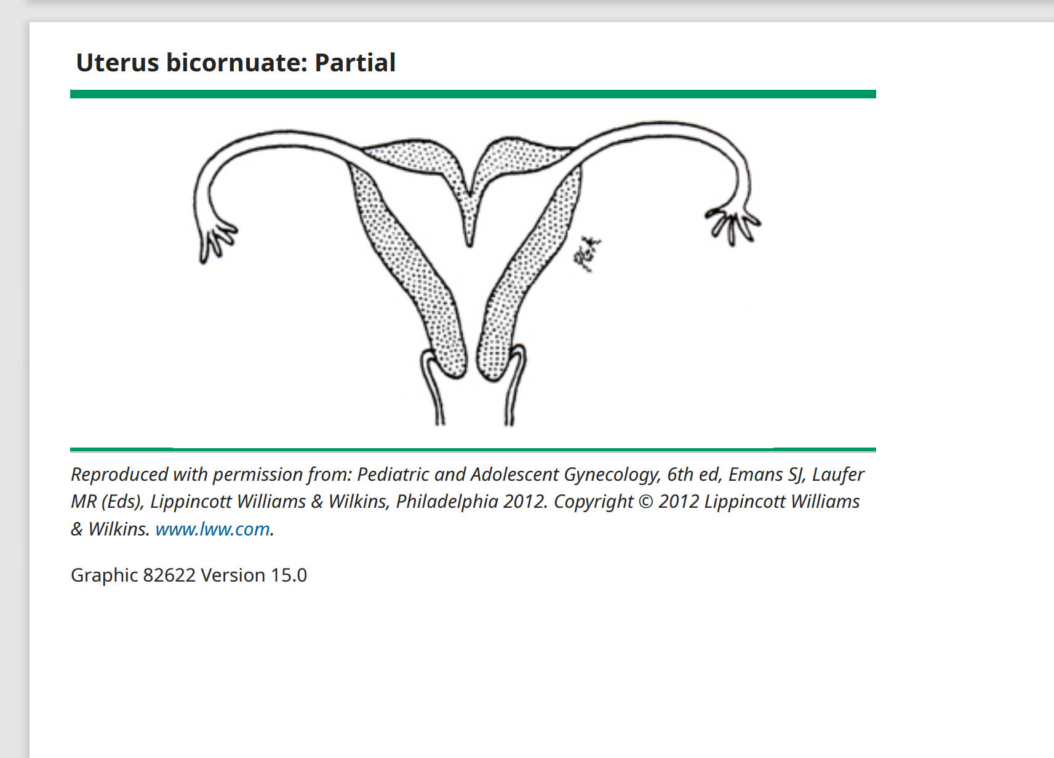
Due to an association between bicornuate uterus and cervical insufficiency, the cervical length should be assessed during pregnancy.

Slide 35
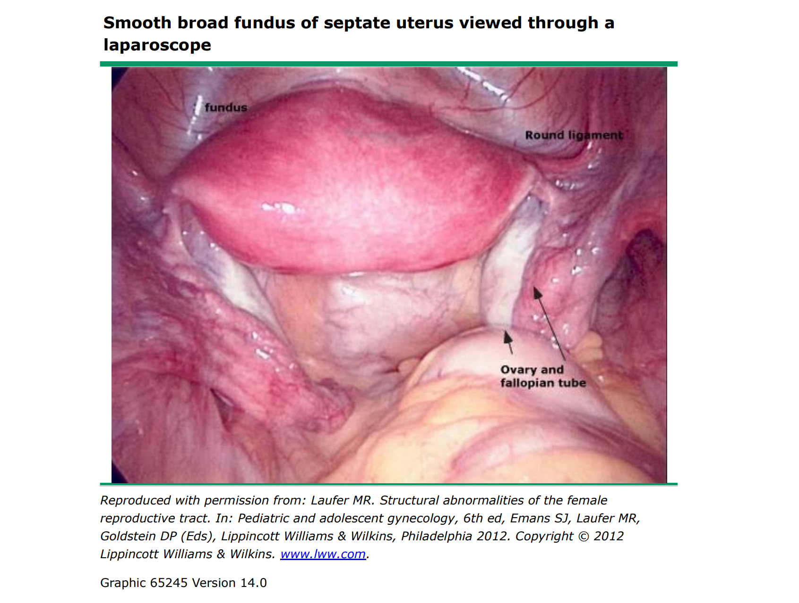
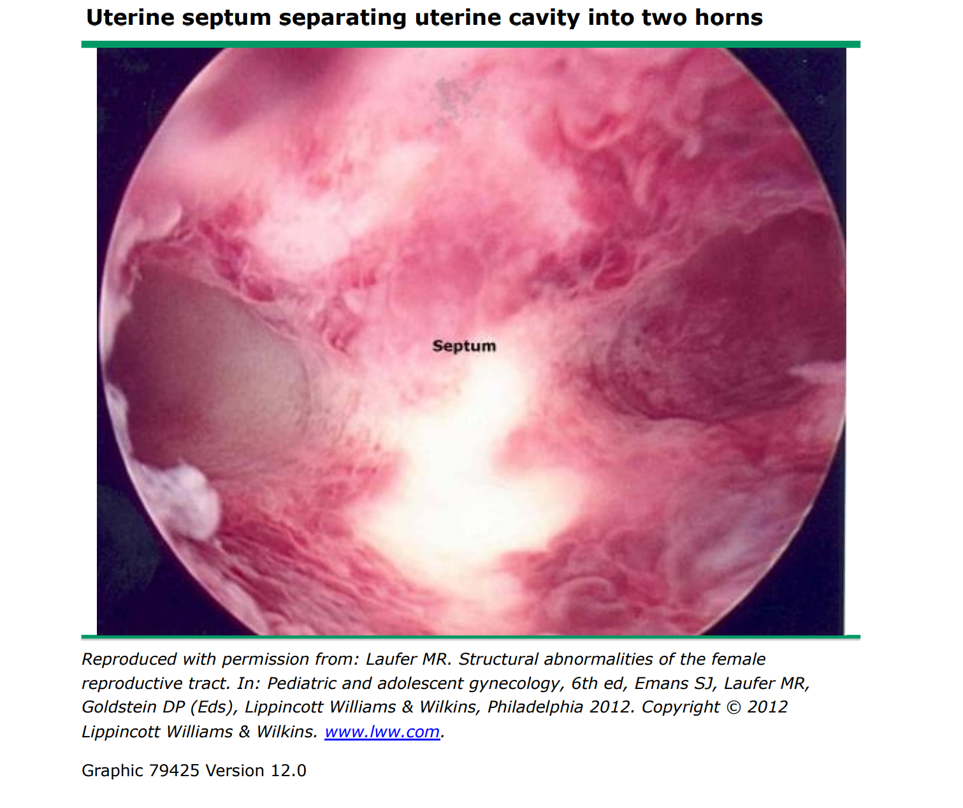
septate uterus

Slide 36
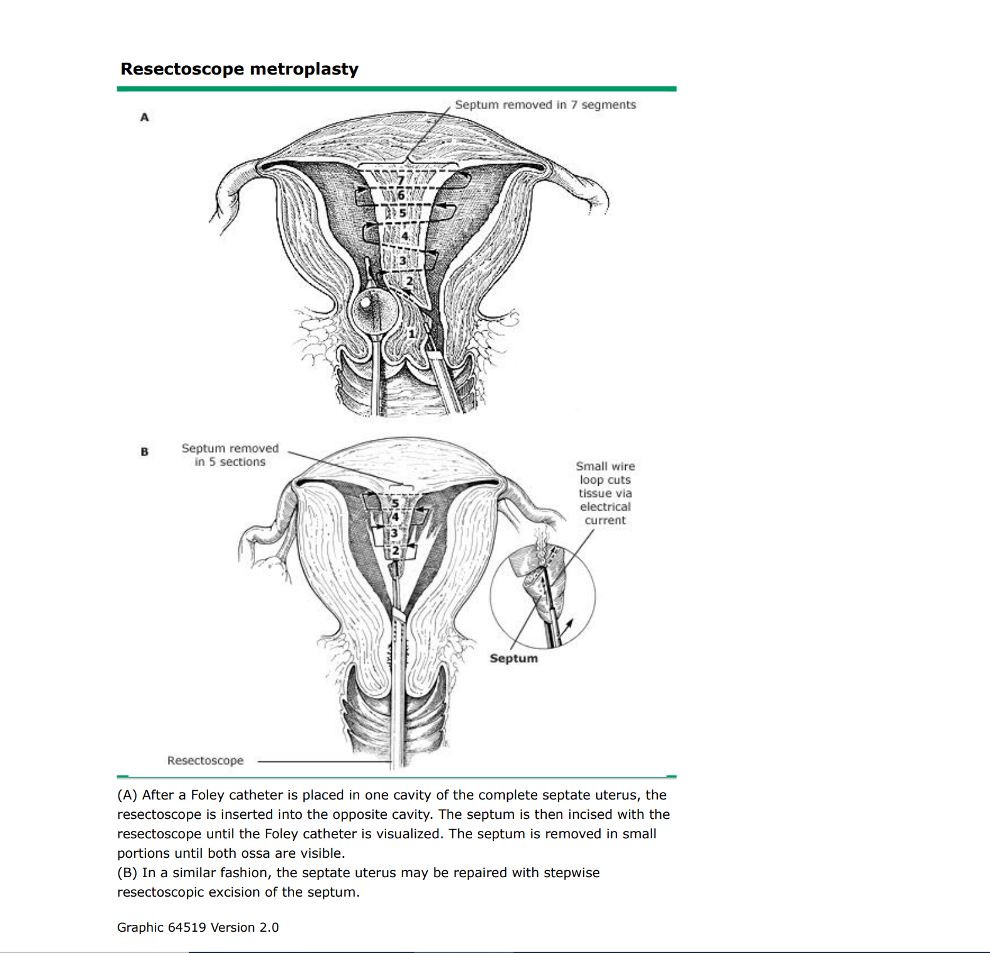
Hysteroscopic metroplasty
Hysteroscopic metroplasty is the preferred method for repair of uterine septa.
Therefore, we typically aim to schedule the procedure in the early follicular phase
Thinner endometrium can be accomplished by pretreatment with a continuous estrogen/progestin contraceptive, progestin-only pill, danazol, or a gonadotropin-releasing hormone (GnRH) agonist.
A partial septum may require only incision of the septum, after which it can be seen to "spring away" and open the upper uterine cavity. A large septum requires resection rather than simple incision

Slide 37

Thank you

